Slide 1
Build & Monitor a Load Balanced Web App on Docker
Matt Williams
DevOps Evangelist @ Datadog
mattw@datadoghq.com
@technovangelist

Slide 2
Agenda
Get started
Add NGINX containers (load balancer and web)
Add the other containers
Configure a dashboard
Add a monitor
Add a check (if time allows)

Slide 3
Get started
The tools we are using:
docker-machine
docker-compose
docker
Clone this repo locally
http://dtdg.co/dkrcon

Slide 4
Get started – where to host
localhost – boot2docker or native (on Linux)
Amazon Web Services
Azure
HP Public Cloud
See the commands.txt in the repo

Slide 5
Get started – Create the docker-machine
docker-machine create --driver vmwarefusion \ fusiondkr
docker-machine create –d amazonec2 \ --amazonec2-access-key $AWS_ACCESS_KEY_ID \ --amazonec2-secret-key $AWS_SECRET_ACCESS_KEY \ --amazonec2-ami $ami \ --amazonec2-instance-type $instancesize \ --amazonec2-vpc-id $vpcid \ --amazonec2-security-group $securitygroup \ --amazonec2-region $region \ $dockerhostname
------
eval (docker-machine env fusiondkr)

Slide 6
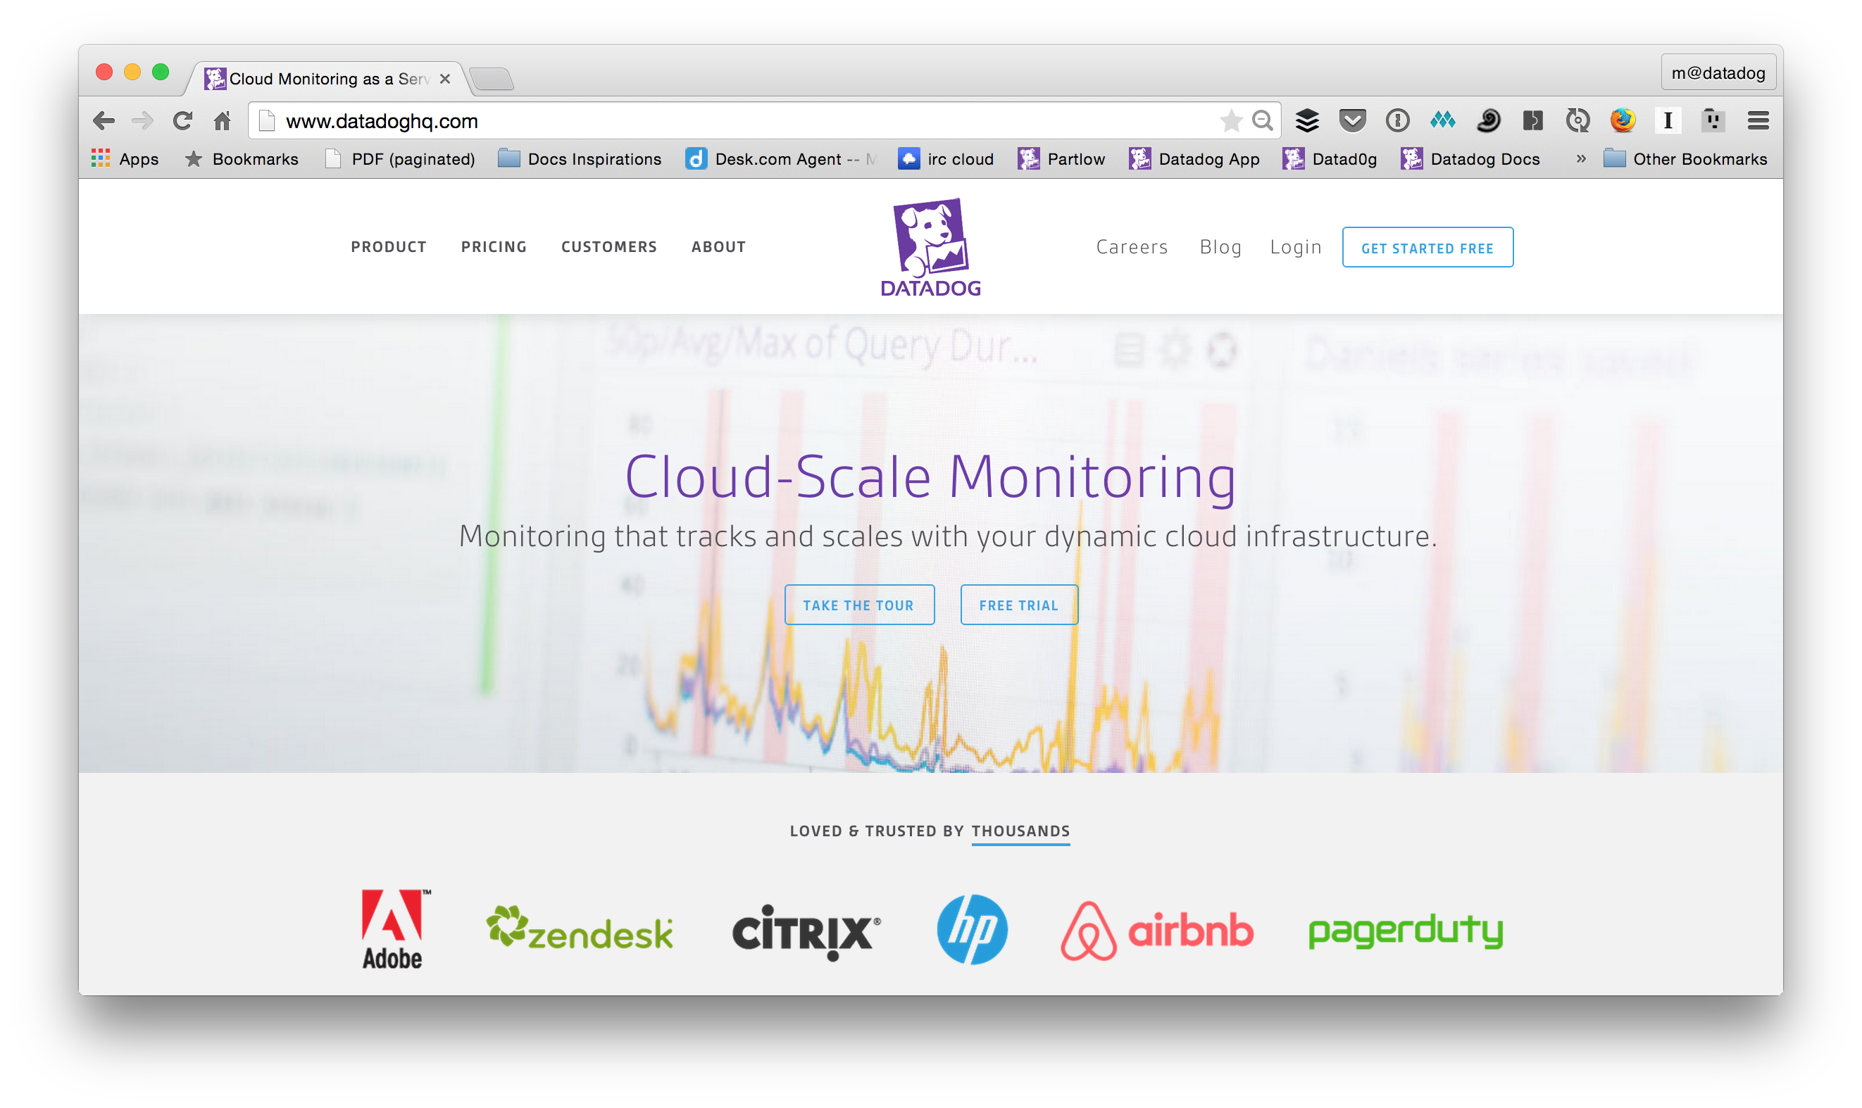
Get started – Create a Datadog account

Slide 7
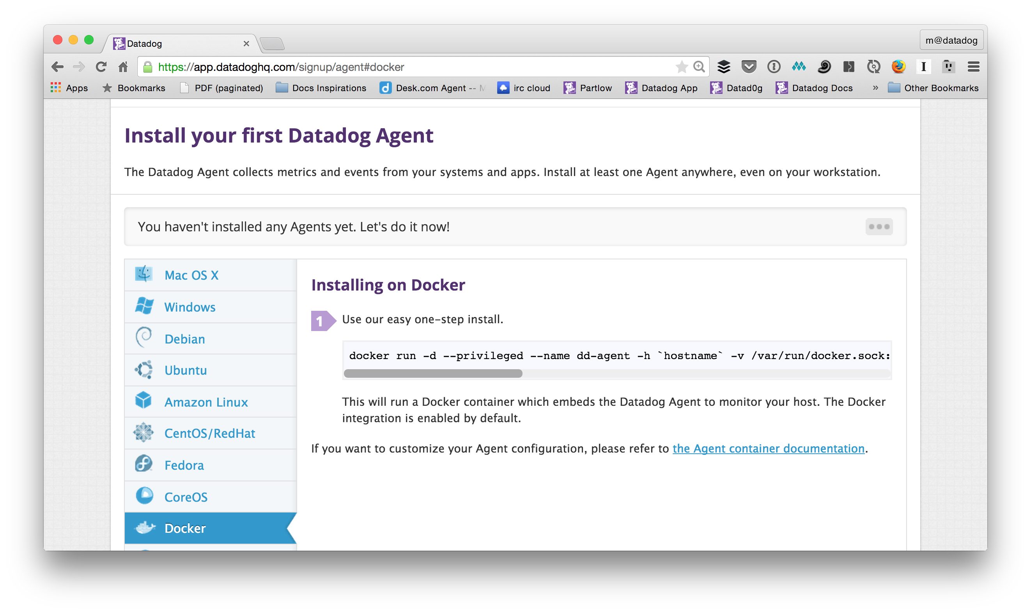
Get started – Setup the Datadog container

Slide 8
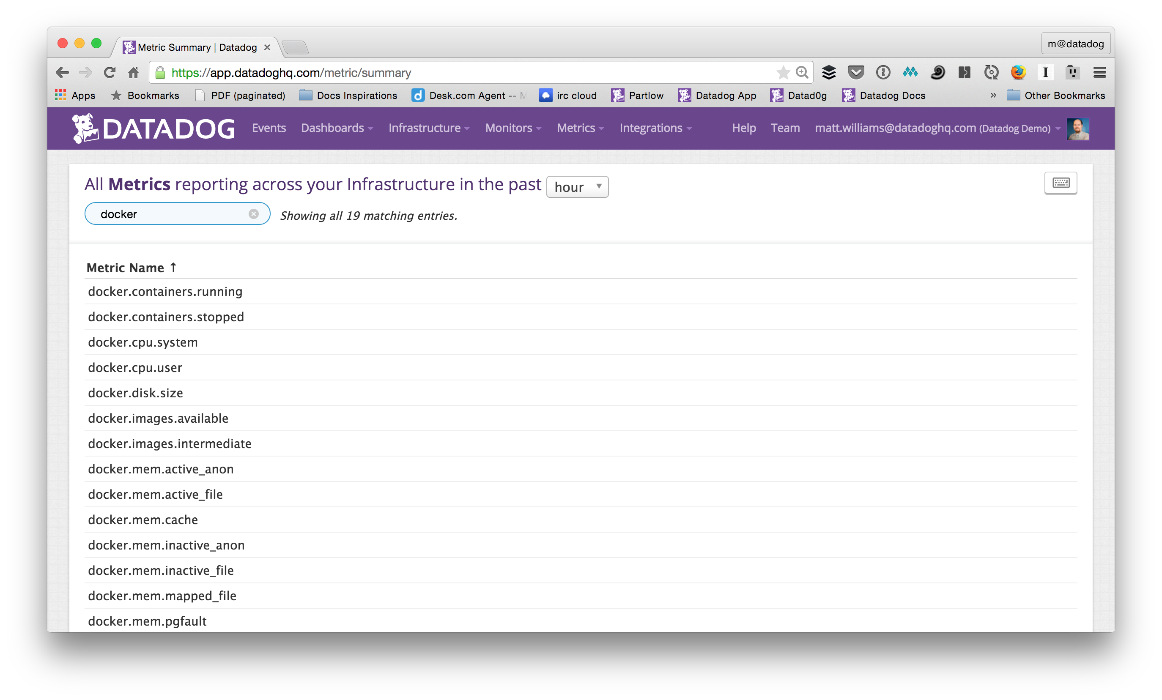
Get started – First metrics

Slide 9
Get started – Use docker-compose
Copy docker-compose-yaml-1 to “docker-compose.yml”
Set environment variable for API_KEY
docker-compose up
docker-compose up –d
docker-compose kill; docker-compose rm
docker-compose kill; docker-compose rm -f; docker-compose build --no-cache;docker-compose up

Slide 10
Get started – Build your first image
Copy dockerfile-first from repo to “first/Dockerfile”
docker build –t first first
docker run –it first
docker run –d first
docker ps
docker kill <container>; docker rm <container>

Slide 11
Get started – Add to docker-compose
Replace docker-compose.yml with docker-compose-yml-2
docker-compose kill; docker-compose rm -f; docker-compose build --no-cache;docker-compose up

Slide 12
Get started – Application architecture
loadbalancer
web
datadog
consul
registrator

Slide 13
Create NGINX web container
Copy nginx-base-dockerfile-1 to nginxbase/Dockerfile
Copy all the files in nginx-base-supervisor to nginxbase/supervisor
Build the image
docker build –t nginxbase nginxbase
Copy nginx-web-dockerfile-1 to web/Dockerfile
Copy nginx-web-nginx.conf to web/nginx.conf
Overwrite docker-compose.yml with docker-compose-yaml-3
docker-compose kill; docker-compose rm -f; docker-compose build –no-cache; docker-compose up

Slide 14
Create NGINX load balancer container
Copy nginx-loadbalancer-dockerfile-1 to loadbalancer/Dockerfile
Copy nginx-loadbalancer-lbnginx.conf to loadbalancer/lbnginx.conf
Copy nginx-loadbalancer-nginx.service to loadbalancer/nginx.service
Overwrite docker-compose.yml with docker-compose-yaml-4
docker-compose kill; docker-compose rm; docker-compose build –no-cache; docker-compose up

Slide 15
Configure Datadog
Copy datadog-dockerfile to dd-agent/Dockerfile
Overwrite docker-compose.yml with docker-compose-yaml-5
docker-compose kill; docker-compose rm; docker-compose build –no-cache; docker-compose up

Slide 16
Use siege to put a load on your web server
see siege.txt

Slide 17
Add containers for consul & registrator
This is going to configure our load balancer for multiple web servers
Update docker-compose yaml with the consul & registrator containers
Overwrite docker-compose.yml with docker-compose-yaml-6
Update loadbalancer container to work with consul
Overwrite loadbalancer/Dockerfile with nginx-loadbalancer-dockerfile-2
Overwrite loadbalancer/lbnginx.conf with nginx-loadbalancer-lbnginx.conf-2
Copy nginx-loadbalancer-consul-template.service to loadbalancer/consul-template.service
docker-compose kill; docker-compose rm; docker-compose up
Run siege again

Slide 18
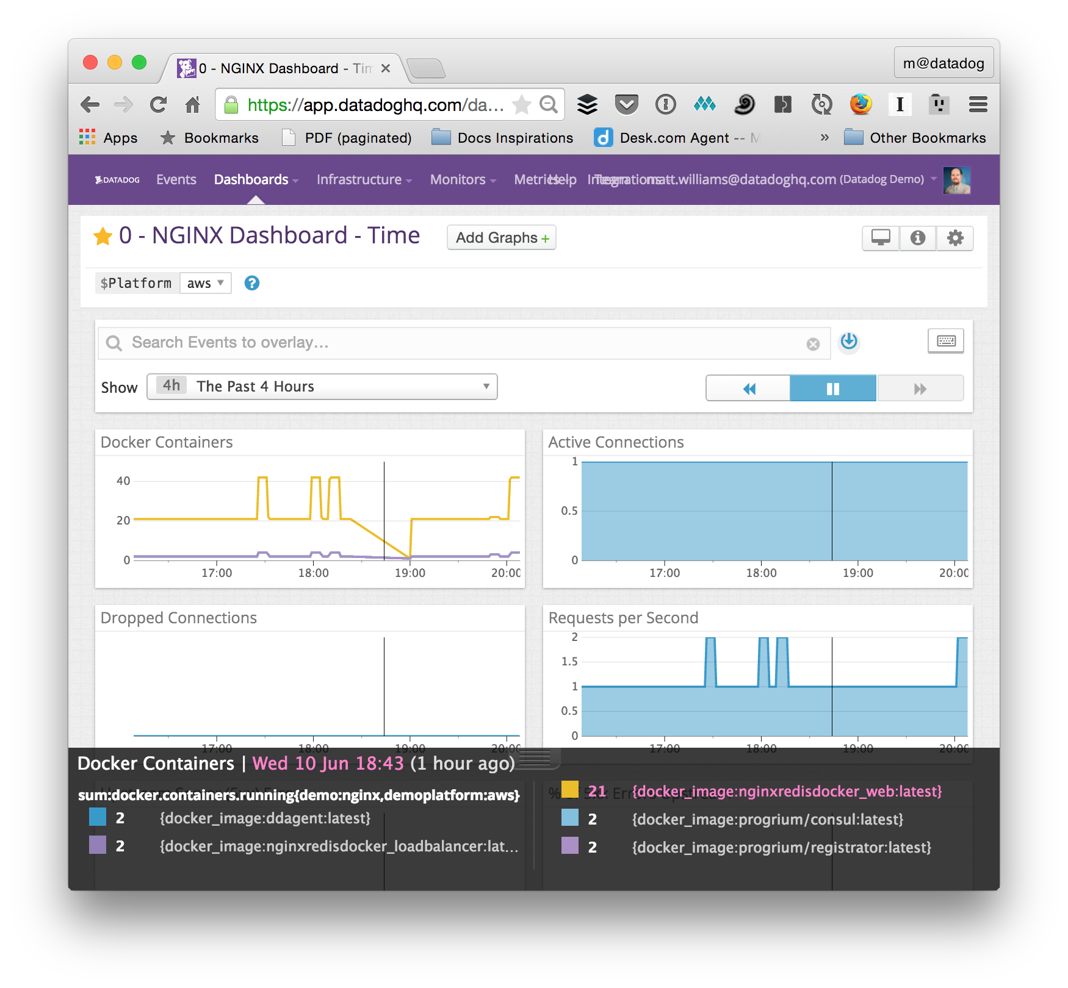
Create a Dashboard
Metrics to consider
Number of docker containers
Active connections
Dropped connections

Slide 19
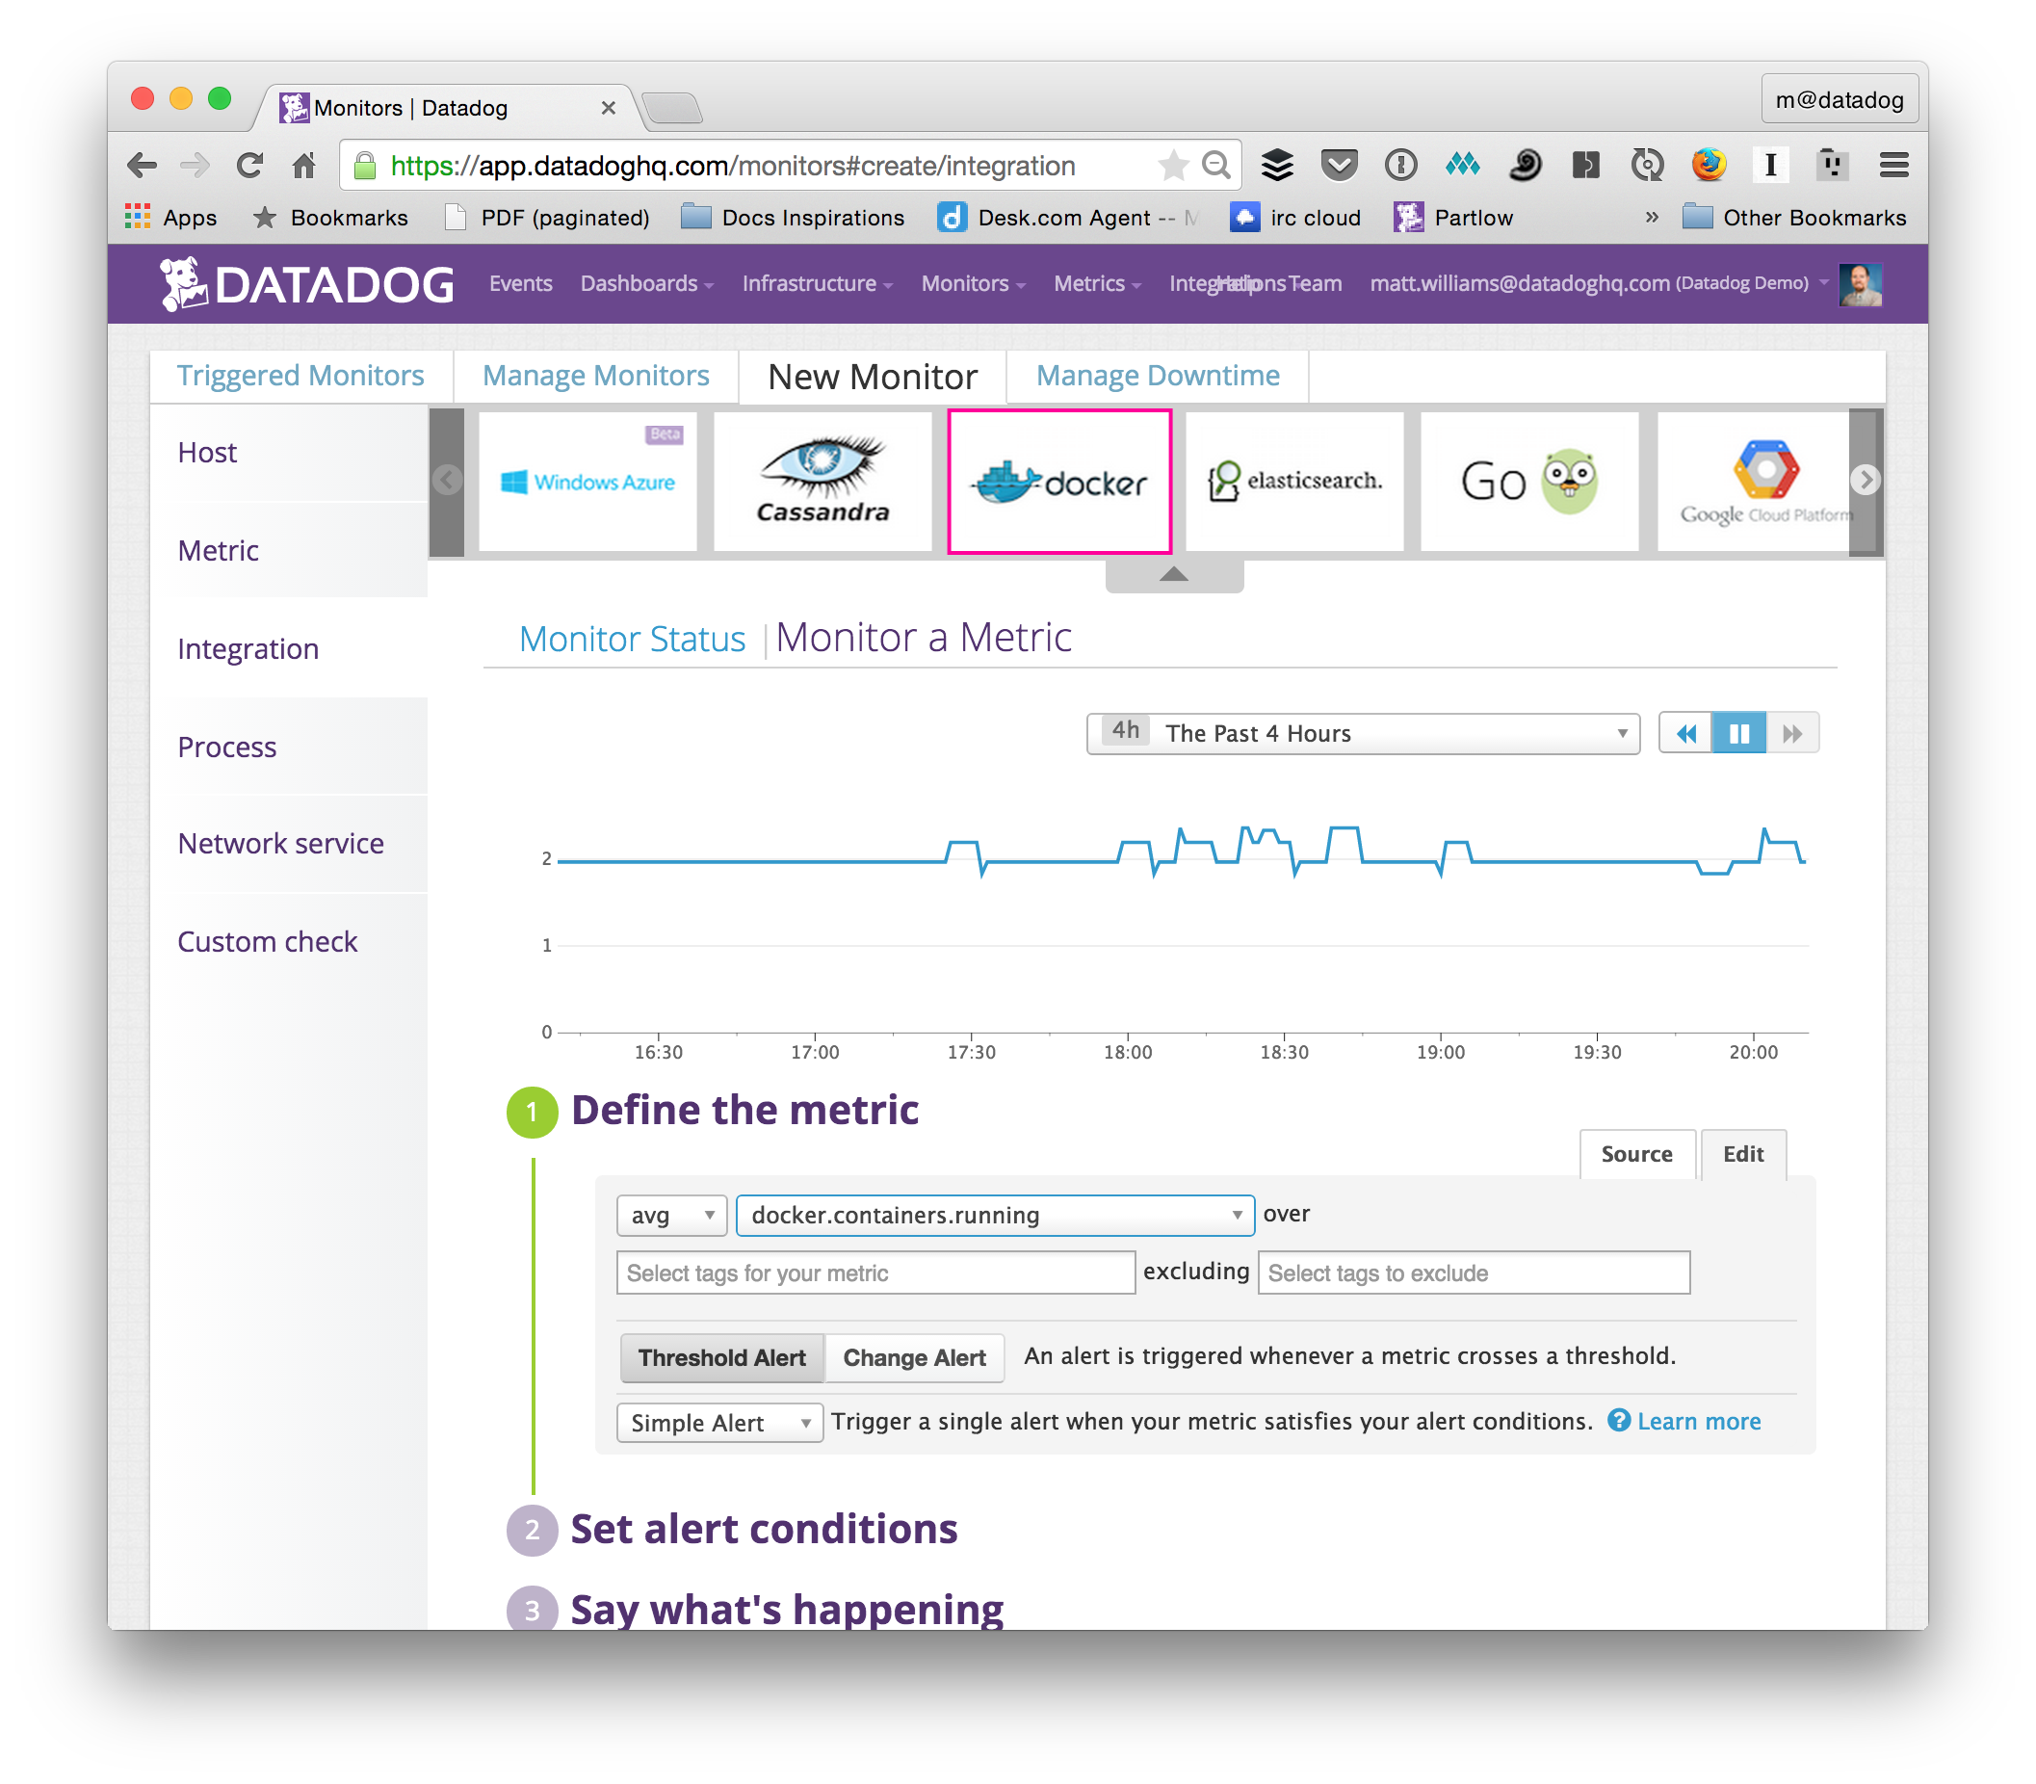
Create a Monitor
Watch docker.containers.running

